Slide 1

Foot Traffic and Dwell Time Trends at Office Supply Stores During the Remote Work Shift
Analyzing customer patterns amid work-from-home changes
Notes:
AI-generated content may be incorrect. ---

Slide 2
Research Questions & Context
Notes:
--- This slide references information from the following file: https://purdue0-my.sharepoint.com/personal/rsana_purdue_edu/_layouts/15/Doc.aspx?sourcedoc=%7BCB5F538E-AD73-4F91-A8F8-8F5817F554D1%7D&file=Group%207_Status_Report%20copy_deck%20reference.docx&action=default&mobileredirect=true Foot Traffic Trends and Demographic Influences

Slide 3
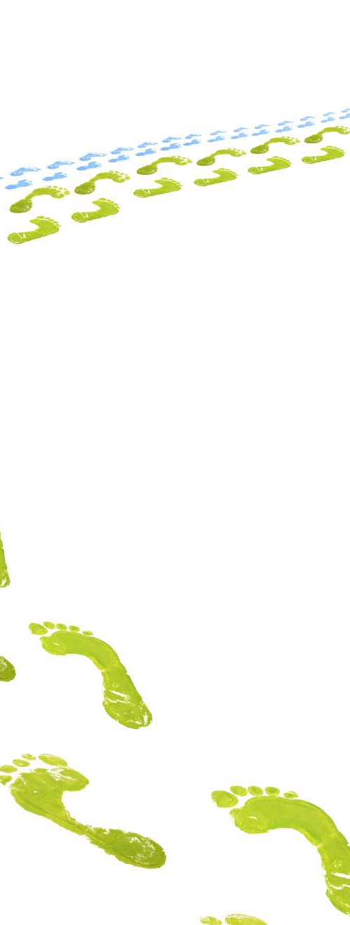
Foot Traffic Trends and Demographic Influences
Behavioral Changes During Pandemic
Study focuses on foot traffic and dwell time trends in office supply stores during early COVID-19 months.
Regional Demographic Analysis
Examines urban, suburban, and rural California counties using RUCA codes and demographic indicators.
Suburban vs Urban Visit Patterns
Analyzes if suburban counties saw stronger visit increases compared to urban centers amid remote work shifts.
Brand Recovery and Loyalty
Evaluates brand-specific recovery patterns showing faster stabilization linked to brand loyalty and essential purchases.
Notes:
--- This slide references information from the following file: https://purdue0-my.sharepoint.com/personal/rsana_purdue_edu/_layouts/15/Doc.aspx?sourcedoc=%7BCB5F538E-AD73-4F91-A8F8-8F5817F554D1%7D&file=Group%207_Status_Report%20copy_deck%20reference.docx&action=default&mobileredirect=true This study investigates how consumer behavior at office supply stores evolved during the initial months of the COVID-19 pandemic, specifically focusing on foot traffic and dwell time trends. The analysis centers on California counties, categorized into urban, suburban, and rural regions. The primary data sources include the SafeGraph dataset for foot traffic and dwell time, RUCA codes for geographic classification, and demographic indicators such as education levels, working-age population, and K–12 households. The first research question explores weekly changes in store visits and dwell times, aiming to identify patterns and shifts in consumer engagement. It also examines how demographic factors like education and household composition influence the potential for innovative retail concepts or expanded community services. The second research question assesses whether suburban counties experienced a stronger rise in visits compared to urban centers during the remote work shift. The third question evaluates brand-specific recovery patterns, focusing on whether certain office supply brands stabilized faster and what this suggests about brand loyalty and essential purchasing behavior.

Slide 4
Methodology
Notes:
--- This slide references information from the following file: https://purdue0-my.sharepoint.com/personal/rsana_purdue_edu/_layouts/15/Doc.aspx?sourcedoc=%7BCB5F538E-AD73-4F91-A8F8-8F5817F554D1%7D&file=Group%207_Status_Report%20copy_deck%20reference.docx&action=default&mobileredirect=true Data Sources and Analytical Approach

Slide 5

Data Sources and Analytical Approach
Data Integration
The study combines datasets including SafeGraph foot traffic and demographic data for comprehensive analysis.
Geographic Classification
2020 RUCA codes classify regions into urban, suburban, and rural counties in California for targeted analysis.
Trend and Brand Analysis
Weekly trends and brand comparisons reveal patterns in recovery and consumer loyalty during the pandemic.
Correlation with Demographics
Correlation analysis links demographics like education and working age with consumer behaviors and dwell times.
Notes:
--- This slide references information from the following file: https://purdue0-my.sharepoint.com/personal/rsana_purdue_edu/_layouts/15/Doc.aspx?sourcedoc=%7BCB5F538E-AD73-4F91-A8F8-8F5817F554D1%7D&file=Group%207_Status_Report%20copy_deck%20reference.docx&action=default&mobileredirect=true The methodology employed in this study integrates multiple datasets to provide a comprehensive view of consumer behavior at office supply stores during the early months of the pandemic. The primary dataset is SafeGraph, which offers granular data on foot traffic and dwell time across various retail locations. To classify geographic regions, the study uses the 2020 Rural-Urban Commuting Area (RUCA) codes, enabling differentiation between urban, suburban, and rural counties in California. Additionally, demographic data is incorporated to analyze the influence of education levels, working-age population (ages 18–64), and K–12 households on store engagement. The analytical approach involves weekly trend analysis from January to April 2020, comparing visit and dwell time metrics across different brands and regions. Brand-level comparisons highlight differences in recovery patterns and consumer loyalty. Correlation analysis is used to link demographic indicators with behavioral metrics, such as longer dwell times in highly educated areas and quicker purchases in working-age dense regions. This multi-faceted methodology allows for a nuanced understanding of how remote work reshaped retail dynamics at the local level.

Slide 6
Key Findings
Notes:
--- This slide references information from the following file: https://purdue0-my.sharepoint.com/personal/rsana_purdue_edu/_layouts/15/Doc.aspx?sourcedoc=%7BCB5F538E-AD73-4F91-A8F8-8F5817F554D1%7D&file=Group%207_Status_Report%20copy_deck%20reference.docx&action=default&mobileredirect=true Brand Performance and Demographic Correlations

Slide 7
Brand Performance and Demographic Correlations
Brand | Working-Age Pop. | Avg. Dwell Time | Observation
Staples | 10.65M | 16.8 | Large workforce → fast purchases.
Cartridge World | 2.05M | 31.1 | Moderate engagement; specialty product line encourages longer visits.
Papyrus | 0.74M | 39.7 | Smaller workforce → more leisurely shopping.
Notes:
--- This slide references information from the following file: https://purdue0-my.sharepoint.com/personal/rsana_purdue_edu/_layouts/15/Doc.aspx?sourcedoc=%7BCB5F538E-AD73-4F91-A8F8-8F5817F554D1%7D&file=Group%207_Status_Report%20copy_deck%20reference.docx&action=default&mobileredirect=true The analysis reveals several key findings regarding brand performance and demographic correlations during the remote work shift. Staples and Office Depot emerged as dominant players, leading in total visits throughout the study period. Staples showed a rapid rebound in Week 17, with visits nearly doubling from 47K to 98K, indicating strong brand loyalty and its perception as an essential retailer. Specialty stores like Papyrus and Rapid Refill attracted fewer visitors but exhibited significantly longer dwell times, suggesting high-intent, focused purchases. Suburban counties demonstrated the highest engagement levels, with faster recovery in visits and dwell times compared to urban and rural areas. Urban regions had slightly lower visits but similar dwell times, reflecting quick, goal-oriented trips. Rural areas saw fewer visits but longer stays, indicating a different shopping behavior. Demographic analysis showed that regions with higher concentrations of bachelor’s and master’s degree holders experienced longer dwell times, possibly due to higher disposable income and preference for personalized shopping experiences. Working-age dense counties exhibited shorter dwell times, consistent with faster shopping habits and limited time availability. These findings underscore the importance of tailoring retail strategies to local demographic profiles.

Slide 8
Conclusions
Notes:
--- This slide references information from the following file: https://purdue0-my.sharepoint.com/personal/rsana_purdue_edu/_layouts/15/Doc.aspx?sourcedoc=%7BCB5F538E-AD73-4F91-A8F8-8F5817F554D1%7D&file=Group%207_Status_Report%20copy_deck%20reference.docx&action=default&mobileredirect=true Consumer Behavior and Retail Implications

Slide 9

Consumer Behavior and Retail Implications
Suburban Efficiency-Driven Shopping
Suburban consumers quickly adapted to remote work, favoring quick, goal-oriented purchases at essential retailers.
Specialty Stores Recovery
Specialty stores faced slower recovery due to non-essential products and reliance on in-store browsing experiences.
Demographic Shopping Preferences
Highly educated, smaller markets prefer longer shopping dwell times and boutique-style experiences over quick shopping.
Retail Strategy Insights
Retailers can tailor strategies by opening concept stores in educated areas and expanding community services in family-dense regions.
Notes:
--- This slide references information from the following file: https://purdue0-my.sharepoint.com/personal/rsana_purdue_edu/_layouts/15/Doc.aspx?sourcedoc=%7BCB5F538E-AD73-4F91-A8F8-8F5817F554D1%7D&file=Group%207_Status_Report%20copy_deck%20reference.docx&action=default&mobileredirect=true The study concludes that suburban consumers adapted more rapidly to remote work requirements, driving early recovery in visits and dwell times at office supply stores. This behavior reflects a shift toward efficiency-driven shopping in high-traffic retailers like Staples and Office Depot. These brands benefited from strong customer loyalty and their essential status, which encouraged consumers to return as soon as stores reopened. In contrast, specialty stores experienced slower recovery due to their non-essential product lines and reliance on in-store browsing. The findings highlight a clear divide between efficiency-driven and experience-driven shopping behaviors. Suburban regions favored quick, goal-oriented purchases, while highly educated, smaller markets exhibited longer dwell times and a preference for boutique-style shopping. Retailers can leverage these insights to tailor their strategies, such as introducing concept stores in educated areas or expanding community services in family-dense regions. Understanding the interplay between demographic factors and consumer behavior is crucial for shaping post-pandemic retail dynamics and enhancing customer engagement.

